Slide 1
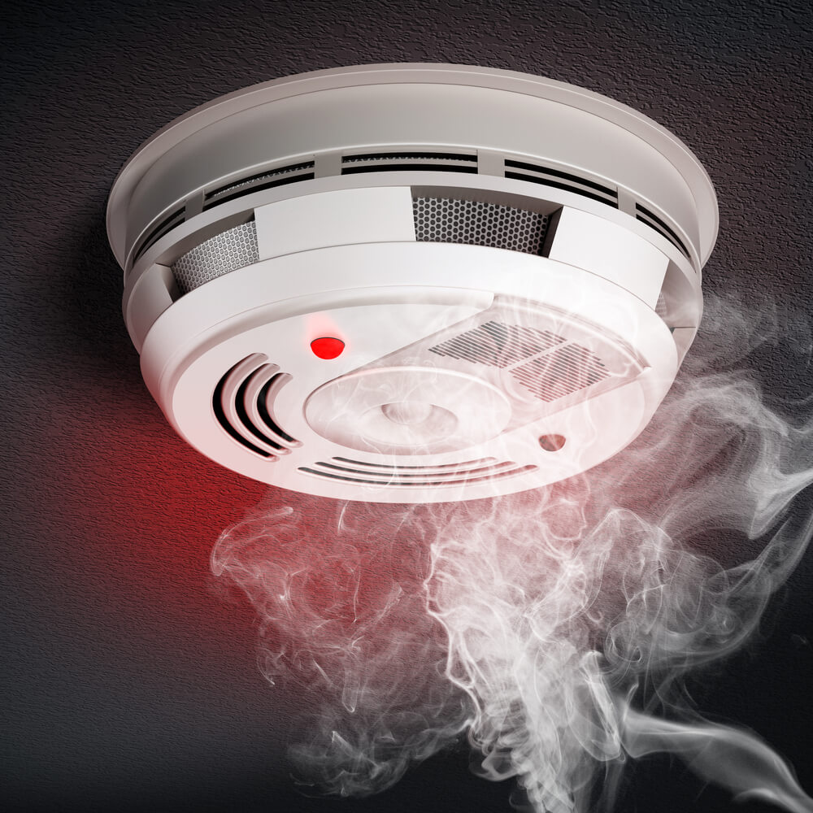
AI-SMOKE DETECTOR “Finding the best model TO DEPLOY INTO AI-SMOKE DETECTOR ”
TEAM “PEERLESS”
SECTION-4

Slide 2
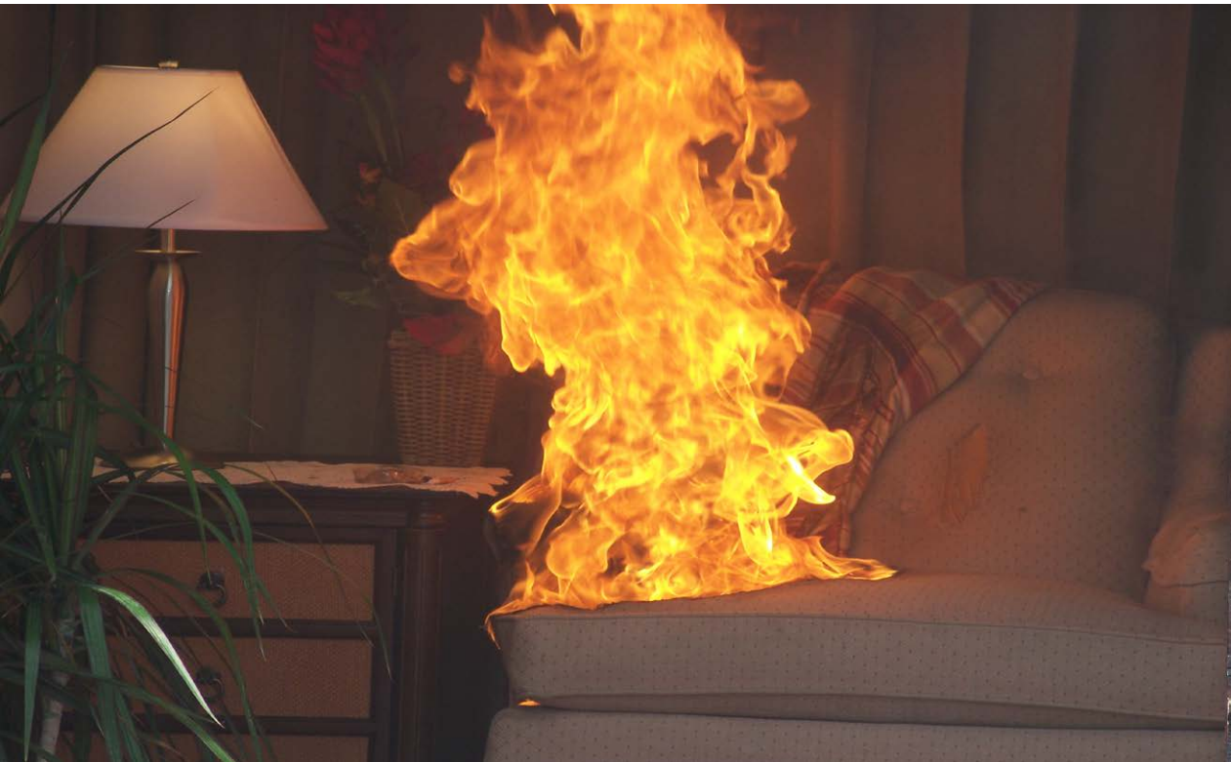
It takes about 3 minutes to go from this…

Slide 3
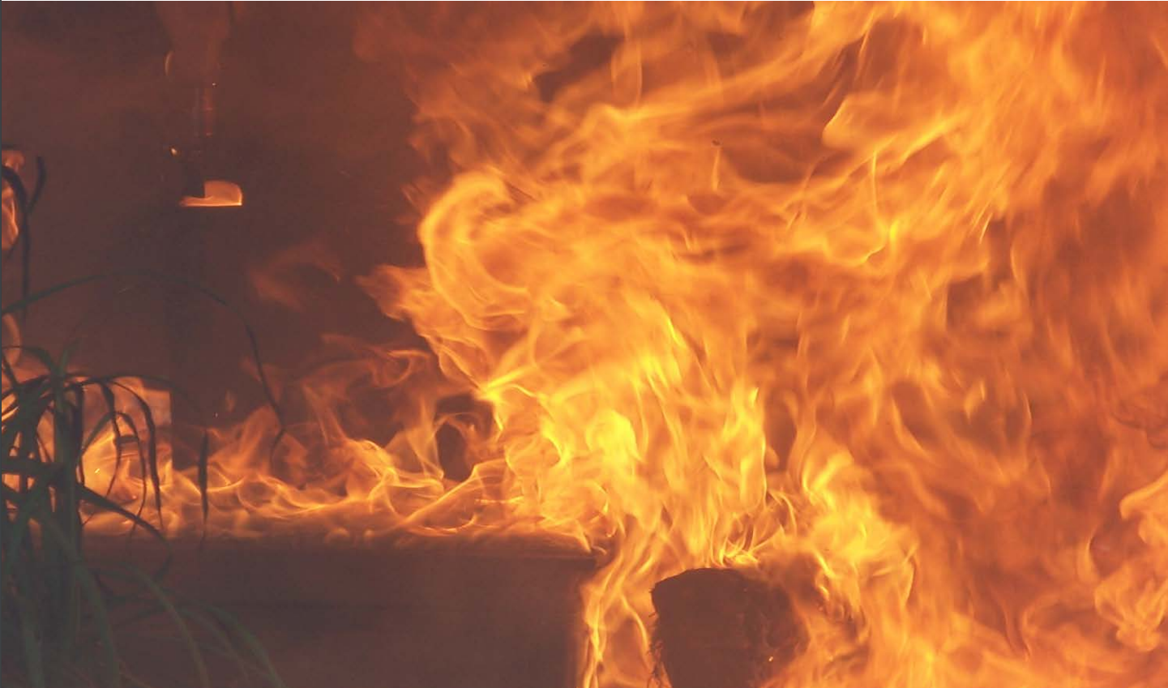
TO THIS!!!

Slide 4
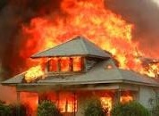
Introduction:
Each year there's an average of 358,000 house fires in USA
These fires result in 7 deaths per day and 8 out of 10 people die from breathing in poisonous smoke.
In the U.S. 96% of all homes have smoke alarms and approximately 20% of homes with smoke alarms have non-operational smoke alarms.
.

Slide 5
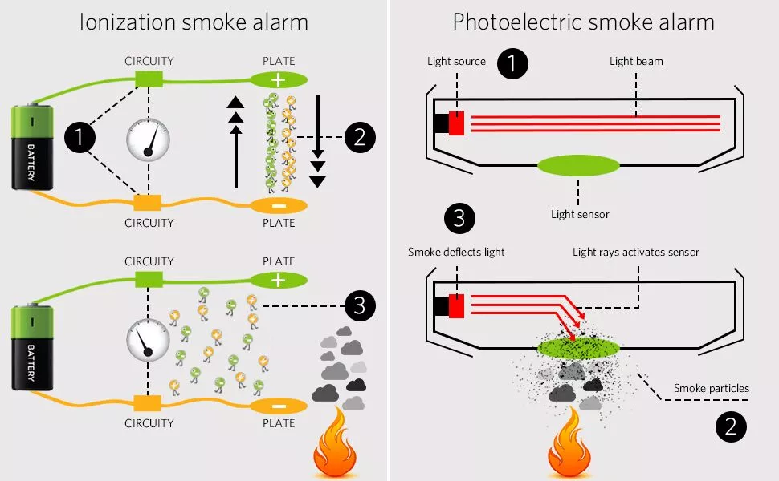
Types of smoke detectors that are already in the market:
Detects smoke from the light when its intensity reduces due to scattering from particles of smoke.
This are sensitive to dust particles and have 11% false alarms rate
Ionization Smoke Detector:
Detects smoke when there is a current differential caused by smoke ions
Photoelectric Smoke Detector:
They are very sensitive and have 92% false alarms rate.

Slide 6
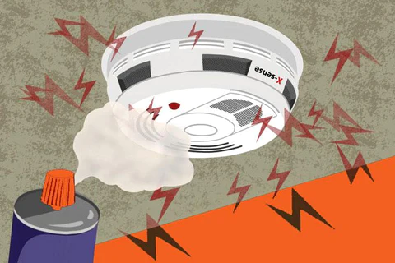
PROBLEM:
With an increasing number of smoke detectors, “false alarms” became a problem.
The number of false fire alarms are increasing continuously, which is a severe issue for firefighters.
Hence the question of the hour is how to reduce the false alarm from the smoke detector ?

Slide 7

Need for a new model(smoke detector):
The existing smoke detectors on the market don't provide us with accurate results and have a high rate of false alarms.
The author, "Stefan Blattmann," a software engineer and volunteer firefighter with six years of experience in development engineer firmware and electronics, decided to develop a new AI-based smoke detector that supports certified preexisting smoke detectors.

Slide 8
Details about Data collection :
Data is collected using a IOT device.
IOT device is a combination of various sensors to collect the data and a aurdino boardto store the data
It is collected at different environmemnts like
Normal indoor
Normal outdoor
Indoor wood fire, firefighter training area
Indoor gas fire, firefighter training area
Outdoor wood, coal, and gas grill
Outdoor high humidity
He collected the data and sampled them so that we can have enough data to perform the anlalysis

Slide 9
Aim:
Our aim is to fit different models and evaluate them on evaluation metrices and decide on the best model which fits the data collected and sampled from different environmental conditions.
We can deploy this model into the AI based smoke detector’s Arduino board, which helps in detecting the smoke from the sensors data.

Slide 10
About data set:
This Data set
No. of Rows : 62.6k
No. of Attributes : 16
Target variable : Fire Alarm
Classification of Target Variable : Binary

Slide 11
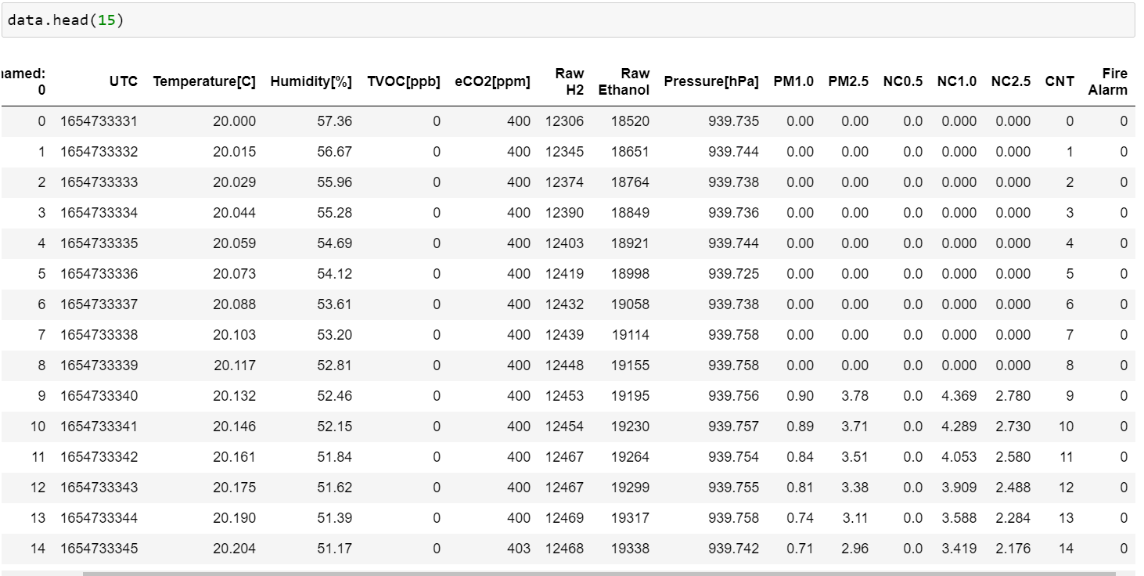
Overview of data:

Slide 12
Data cleaning:
We have 15 independent variable columns and one target column
Removing unnecessary columns like Time stamp(UTC), Sample Counter(Unnamed:_0), Indexing column(CNT)
Checking for null values and removing them if there are any
We end up with 12 independent variable columns and all the data remains the same because there are no missing values
Converting all the column name into simpler names so that we can call them easily in our further code¶

Slide 13
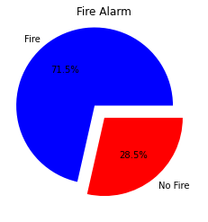


Slide 14
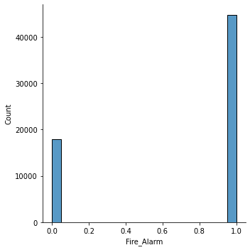
Evaluation Metrics:
Our goal is to reduce the False Alarms. Which means, the smoke detector predicting smoke when there is no smoke. Which is our false positive and this must be reduced.
As all the false negatives are more dangerous than fall positives and cannot be neglected, we can assume “Recall” as our best scoring metric.
But as we have imbalance in the data, we are considering the “F1-Score” to be our evaluation metric and decide the best model based on the F1 score.

Slide 15
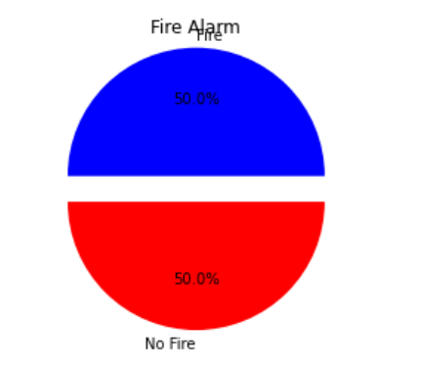
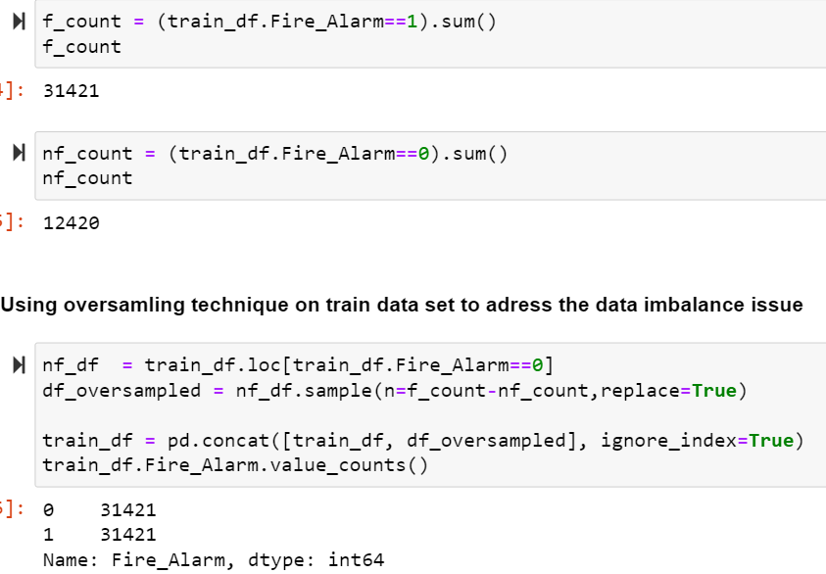
BALANCING THE TARGET VARIABLE
OVER SAMPLING method is used for balancing

Slide 16
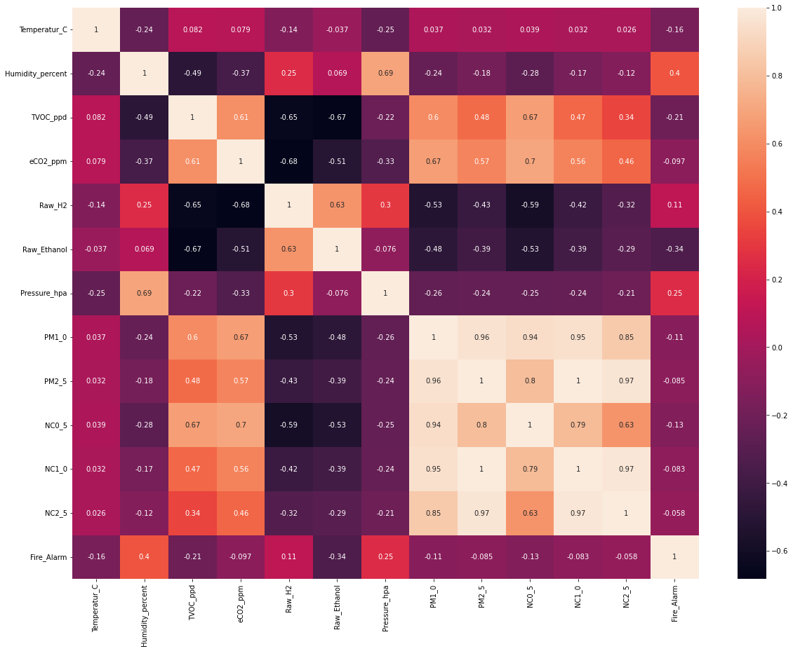

Slide 17
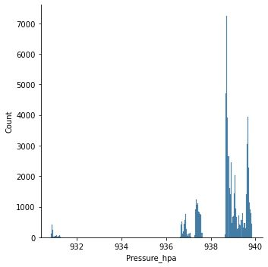
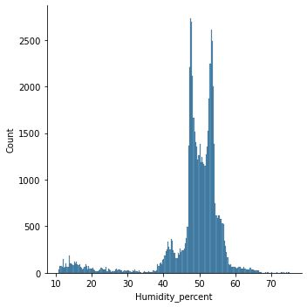
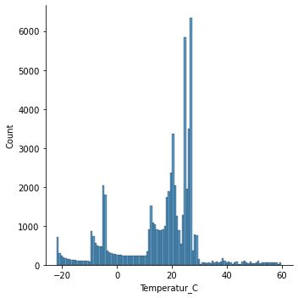

Slide 18
Description on Attributes:
UTC : Timestamp UTC seconds (Continuous Variable)
Temperature[C] : Air Temperature (Continuous Variable)
Humidity[%] : Air Humidity (Continuous Variable)
TVOC[ppb] : Total Volatile Organic Compounds (Continuous Variable)
eCO2[ppm] : co2 equivalent concentration (Continuous Variable)
Raw H2 : raw molecular hydrogen (Continuous Variable)
Raw Ethanol : raw ethanol gas (Continuous Variable)
Pressure[hPa] : Air Pressure (Continuous Variable)
PM1.0 and PM2.5 : particulate matter size (Continuous Variable)
NC0.5/NC1.0 and NC2.5 : Number concentration of particulate matter. (Continuous Variable)
CNT : Sample counter (Continuous Variable)
Fire Alarm : To detect whether smoke is detected or not (Categorical Variable/ Target Variable)

Slide 19
MODELS FOR PREDICTION:
KNN
Decision Tree
Random Forest
Ada Boost
Gradient Boosting
XG Boost
ML Classifiers

Slide 20
Analysis flow
Splitting the data into training set and testing/validation set using train test split with the split ratio of 70-30
Fitting the model into the training set and training the model
Fitting the trained model into test set and getting the predicted output
By comparing the predicted output with actual output, we will get our evaluation scores

Slide 21
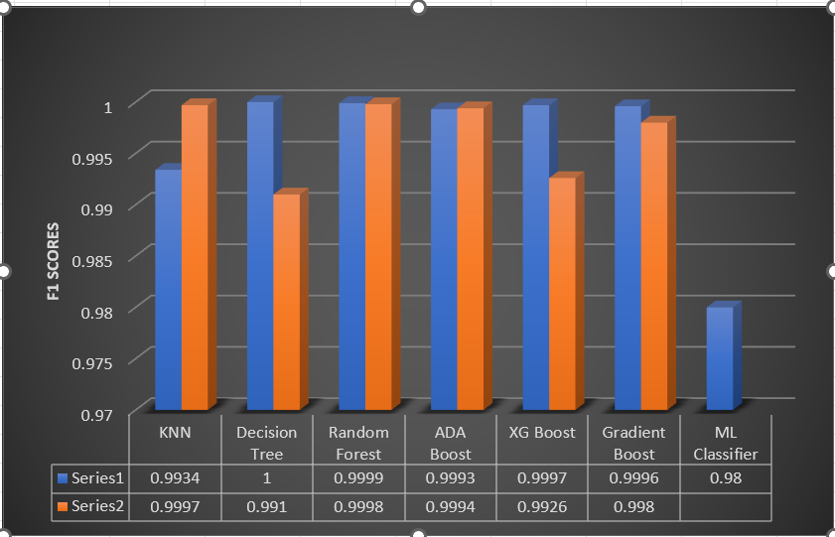
Comparison of F1 Scores across Different Models:
Series1:- Model without tuning
Series2:- Model with tuning
All models have nearly same f1 score and almost equal to “1” which indicates all the models are fitting and predicting well.
Random forest model has the best f1 score of all the models

Slide 22
Best Model:
Decision Tree
Random Forest
Ada Boost
Gradient Boosting
XG Boost
RANDOM FOREST
KNN
We have got the highest f1 score for Random forest without hyper parameter tuning and the second highest score is also Random forest with hyper parameter tunning
There is no much difference between the scores, so we can assume Random forest with hyper parameter tunning as the best model because it is more tunned than the normal Random forest

Slide 23
conclusion
Now that we got our best model which is Random forest, we can give this model to the author who later can deploy this model algorithm into the Arduino board(any CPU ).
This AI based smoke detector will collect all the input variables and the model in the CPU will analyze them and give them the predicted output.
Therefore, the fire signal is sent only when both certified smoke detectors and this AI based detector detects smoke.

Slide 24

Hema Sai Ari
Sai Kiran Reddy Rajannagari
Hima bindu Krishnouth
Maruthi Sai Vishnu Varma Vanapala
Hema Venkatesh Prasad Sabbavarapu

